Slide 1
Configuring Security for Users and Applications
OW

Slide 2
Definitions
Role-based access control (RBAC) objects determine whether a user is allowed to perform a given action within a project.
Cluster administrators can use the cluster roles and bindings to control who has various access levels to the OpenShift Container Platform platform itself and all projects.
Developers can use local roles and bindings to control who has access to their projects. Note that authorization is a separate step from authentication, which is more about determining the identity of who is taking the action.

Slide 3
..
Authorization object | Description
Rules | Sets of permitted verbs on a set of objects. For example, whether a user or service account can create pods.
Roles | Collections of rules. You can associate, or bind, users and groups to multiple roles.
Bindings | Associations between users and/or groups with a role.

Slide 4
..
RBAC level | Description
Cluster RBAC | Roles and bindings that are applicable across all projects. Cluster roles exist cluster-wide, and cluster role bindings can reference only cluster roles.
Local RBAC | Roles and bindings that are scoped to a given project. While local roles exist only in a single project, local role bindings can reference both cluster and local roles.

Slide 5
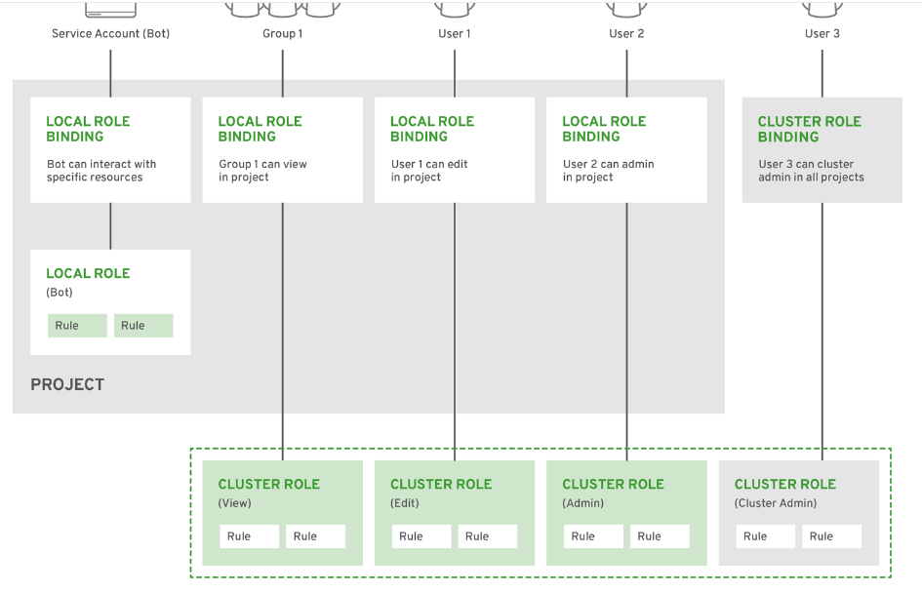
..

Slide 6
..
Identity
The user name and list of groups that the user belongs to.
Action
The action you perform. In most cases, this consists of:
Project: The project you access. A project is a Kubernetes namespace with additional annotations that allows a community of users to organize and manage their content in isolation from other communities.
Verb : The action itself: get, list, create, update, delete, deletecollection, or watch.
Resource name: The API endpoint that you access.

Slide 7
Binding
The full list of bindings, the associations between users or groups with a role.
OpenShift Container Platform evaluates authorization by using the following steps:
The identity and the project-scoped action is used to find all bindings that apply to the user or their groups.
Bindings are used to locate all the roles that apply.
Roles are used to find all the rules that apply.
The action is checked against each rule to find a match.
If no matching rule is found, the action is then denied by default.

Slide 8
What is RBAC?
Role-Based access control (RBAC) is method of regulating the access to computer or network resources based on the roles.
RBAC authorization uses the rbac.authorization.k8s.io api to drive authorization decision.
RBAC declares four kind of objects:
Role
ClusterRole
RoleBinding
ClusterRoleBinding

Slide 9
RBAC vs CLUSTERROLE
A Role always sets permissions within a particular namespace; when you create a Role, you have to specify the namespace it belongs in.
ClusterRoles, by contrast, is a non-namespaced resource.
ClusterRoles have several uses. You can use a ClusterRole to:
define permissions on namespaced resources and be granted access within individual namespace(s)
define permissions on namespaced resources and be granted access across all namespaces
define permissions on cluster-scoped resources

Slide 10
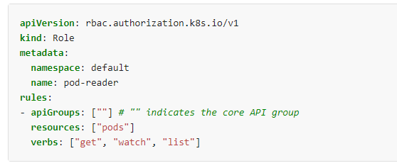
Role example

Slide 11
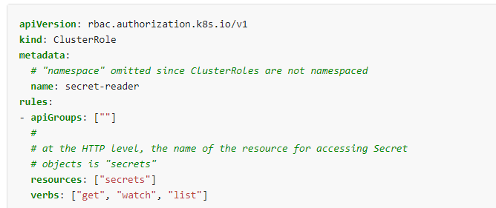
ClusterRole

Slide 12
What next: RoleBinding and ClusterRoleBinding
A role binding grant the permission defined in a role to a user or set of users.
Its holds a list of subjects such as users,group,service account and a reference to the role being granted.
A RoleBinding is specific to namespace
A ClusterRoleBinding grants access cluster-wide
A RoleBinding can refer to ClusterRole as well.
If you bind a ClusterRole to all the namespace, use ClusterRoleBinding

Slide 13
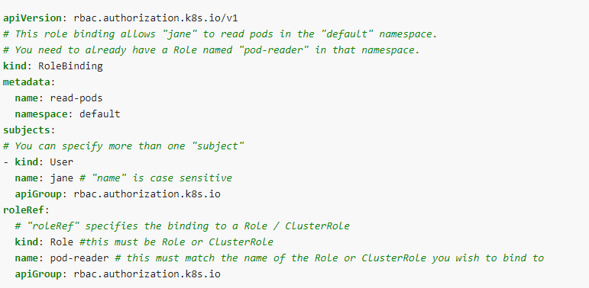
RoleBinding Refer to Role

Slide 14
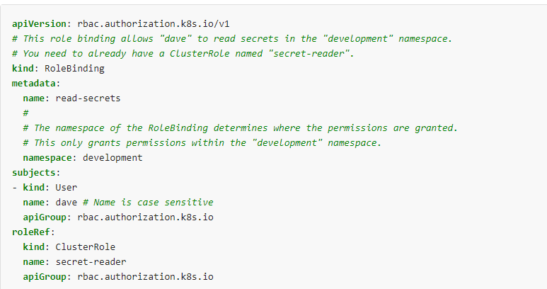
RoleBinding Refer to ClusterRole

Slide 15
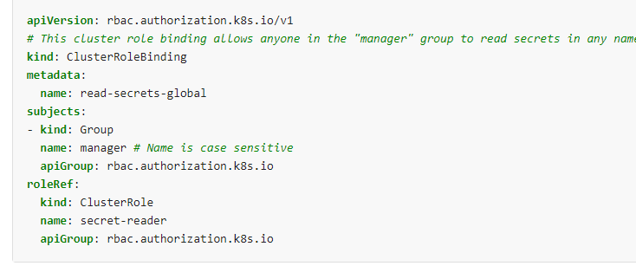
ClusterRoleBinding Example

Slide 16
Good To know facts
After you create a binding, you cannot change the Role or ClusterRole that it refers to. If you try to change a binding's roleRef, you get a validation error.
If you do want to change the roleRef for a binding, you need to remove the binding object and create a replacement.
Any change in roleRef, binding need to be recreated.
The kubectl auth reconcile command-line utility creates or updates a manifest file containing RBAC objects, and handles deleting and recreating binding objects if required to change the role they refer to

Slide 17
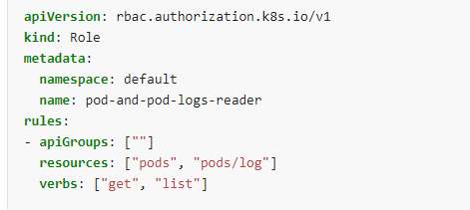
Referring to resources
In the Kubernetes API, most resources are represented and accessed using a string representation of their object name, such as pods for a Pod. RBAC refers to resources using exactly the same name that appears in the URL for the relevant API endpoint.
In this case, pods is the namespaced resource for Pod resources, and log is a subresource of pods. To represent this in an RBAC role, use a slash (/) to delimit the resource and subresource. To allow a subject to read pods and also access the log subresource for each of those Pods, you write

Slide 18

How to access sub resources
kubectl proxy &
curl -s http://localhost:8001/api/v1/namespaces/default/pods/

Slide 19
Don’t use wildcards
Using wildcards in resource and verb entries could result in overly permissive access being granted to sensitive resources. For instance, if a new resource type is added, or a new subresource is added, or a new custom verb is checked, the wildcard entry automatically grants access.

Slide 20
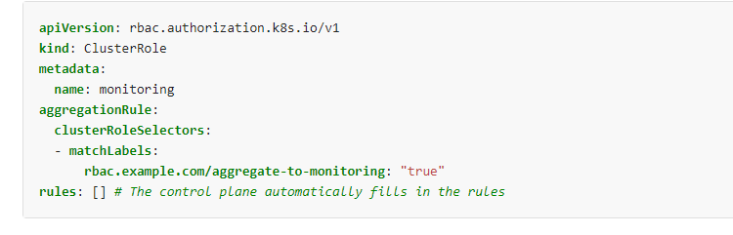
Aggregated ClusterRoles
aggregate several ClusterRoles into one combined ClusterRole
The aggregationRule defines a label selector that the controller uses to match other ClusterRole objects that should be combined into the rules field of this one.

Slide 21
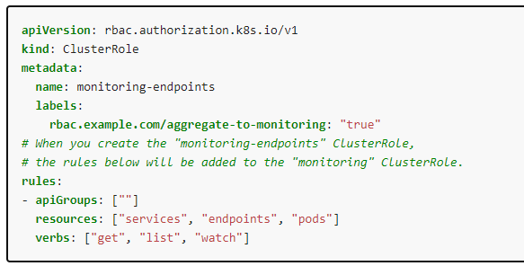
..

Slide 22
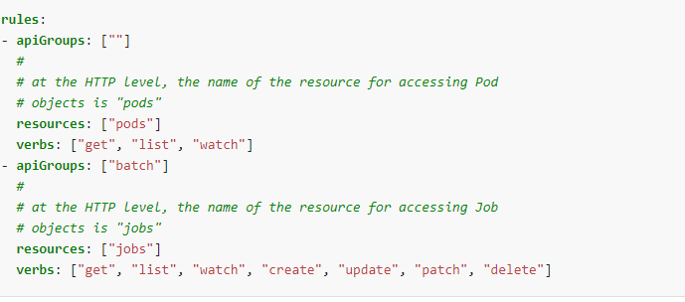
Rules

Slide 23
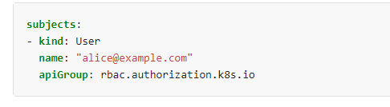
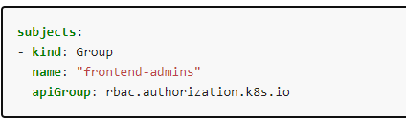
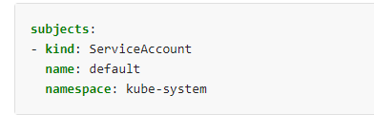
Subject in RoleBinding
A RoleBinding or ClusterRoleBinding binds a role to subjects. Subjects can be groups, users or ServiceAccounts.

Slide 24
Try commands and yaml
Labs and cmds

